Slide 1
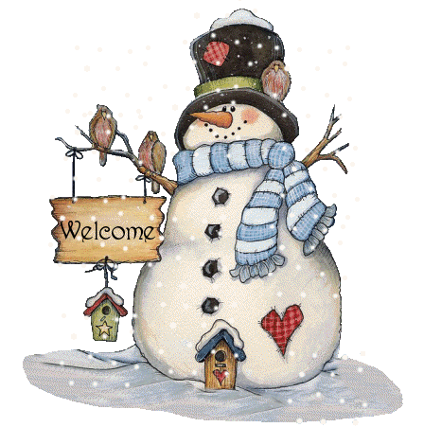
WELCOME TO GRADE 4
Teacher: Mrs Ly

Slide 2
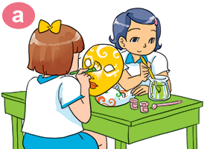
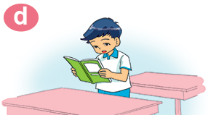
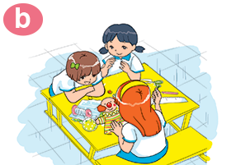
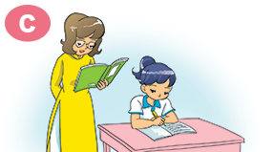
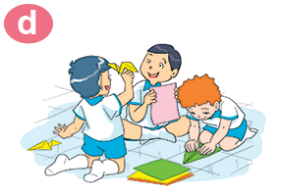
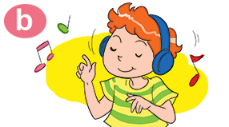
a
writing a dic‘tation
6
1
b
painting masks
c
drawing pictures
2
5
d
listening to music
e
making paper planes
3
4
reading a text
f

Slide 3
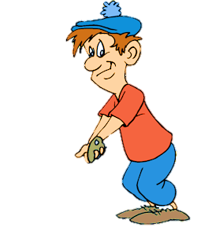
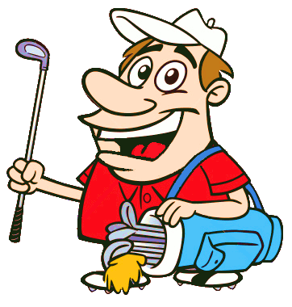

Slide 4
reading a text
___________________
A
B
watching a video
reading a text
NEXT

Slide 5
_________________________
writing a dictation
A
B
writing a dictation
listening to music
NEXT

Slide 6
_________________________
painting masks
A
B
painting masks
drawing pictures
NEXT

Slide 7
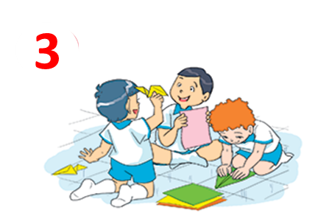
_______________________
making paper planes
A
B
watching a video
making paper planes
NEXT

Slide 8
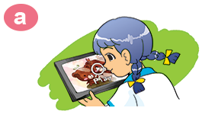
__________________________
watching a video
A
B
watching a video
reading a text
NEXT

Slide 9
Textbook
Page 59
(Listen and tick)

Slide 10
Sunflowers
Notes:
Ms Huyền Phạm - 0936.082.789 – YOUTUBE: MsPham. Facebook: Dạy và học cùng công nghệ.

Slide 11
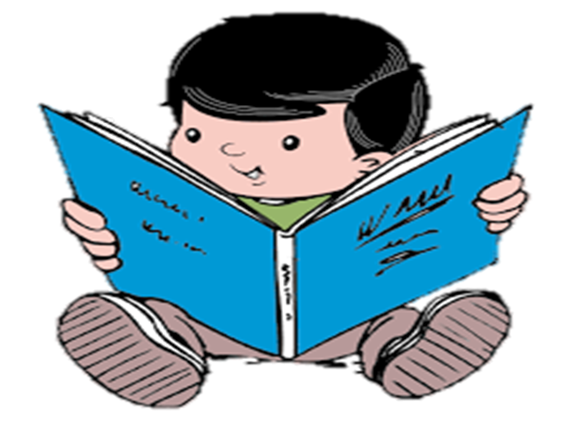
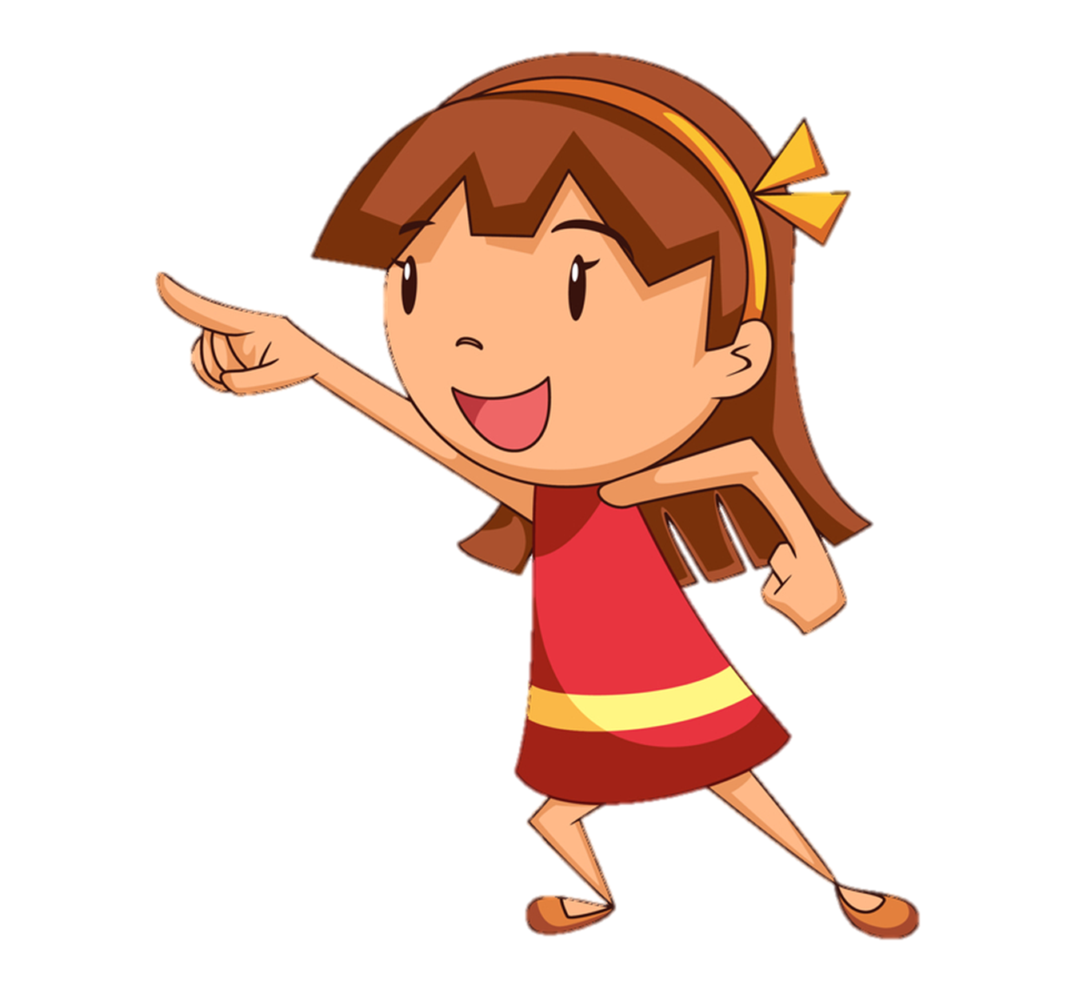
A
B
He’s reading a book.
She’s reading a book.
Notes:
Ms Huyền Phạm - 0936.082.789 – YOUTUBE: MsPham. Facebook: Dạy và học cùng công nghệ.

Slide 12
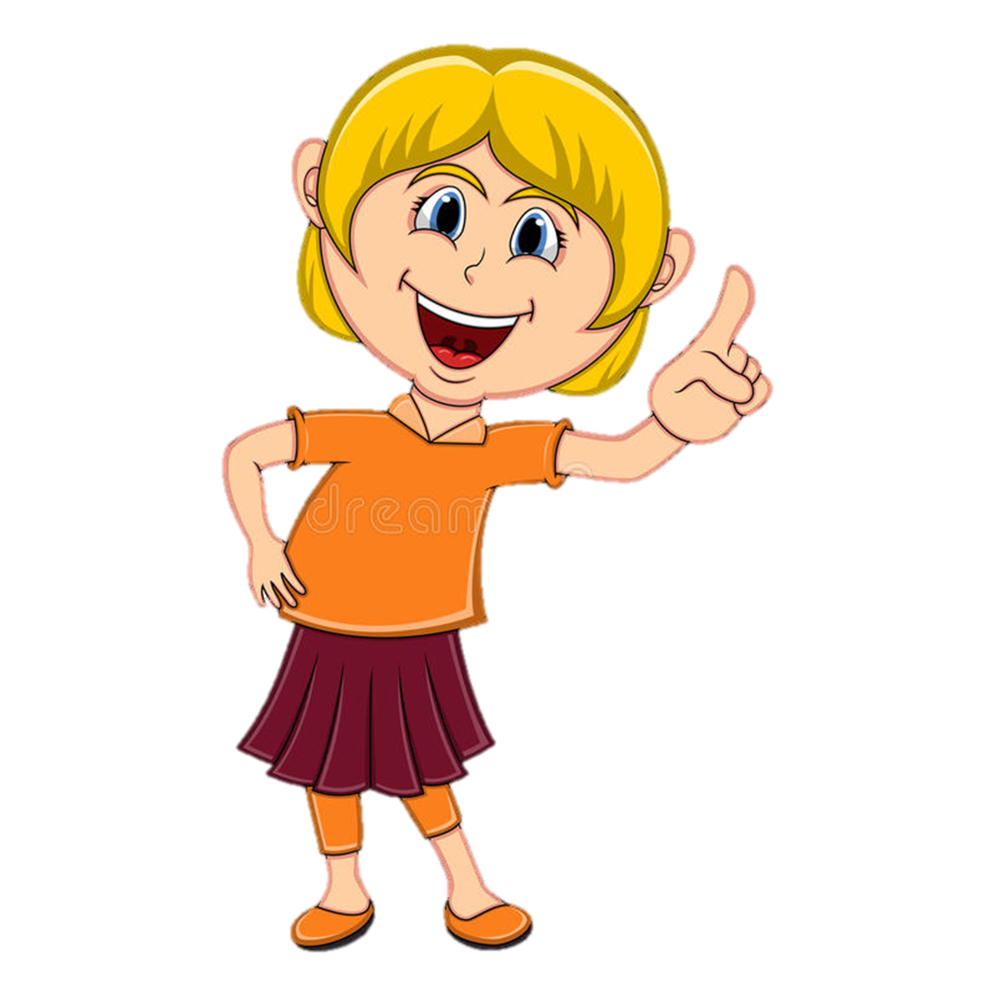
A
B
He’s writing a dictation.
She’s writing a dictation.
Notes:
Ms Huyền Phạm - 0936.082.789 – YOUTUBE: MsPham. Facebook: Dạy và học cùng công nghệ.

Slide 13
A
B
She is painting masks.
They are painting masks.
Notes:
Ms Huyền Phạm - 0936.082.789 – YOUTUBE: MsPham. Facebook: Dạy và học cùng công nghệ.

Slide 14
What are they doing?
A
B
He’s making paper planes.
They’re making paper planes.
Notes:
Ms Huyền Phạm - 0936.082.789 – YOUTUBE: MsPham. Facebook: Dạy và học cùng công nghệ.

Slide 15
What is she doing?
A
B
He’s listening to music.
She is listening to music.
Notes:
Ms Huyền Phạm - 0936.082.789 – YOUTUBE: MsPham. Facebook: Dạy và học cùng công nghệ.

Slide 16
What ________ doing?
are they
is he/she
_________ watching TV
They are
He/she is
Notes:
Ms Huyền Phạm - 0936.082.789 – YOUTUBE: MsPham. Facebook: Dạy và học cùng công nghệ.

Slide 17
Hoi
Vocabulary
Sentences
1. Hỏi một người nào đó đang làm gì?
making paper planes
What is he/she doing?
reading a text
He/she is singing
2. Hỏi nhiều người nào đó đang làm gì?
writing a dictation
painting masks
What are they doing?
They are singing

